Slide 1
ENDOMETRIOSIS TEMPLATE
IDEA
Date: day/month/year

Slide 2
General Info (remove this slide before submission)
Use the template in the following slides
Remember to remove patient identifiable data on every image and clip

Slide 3
Consent
Please confirm the following statements by adding an ‘v’ in the box:
(*) I confirm that there is no patient-identifiable information in the slides submitted and that I have obtained appropriate consent to share this case. I understand that if my case is selected for presentation, the Case Stream session will be recorded and made available online to registered Gynaia members.
(*) I would like my case to be included in the upcoming Gynaia Case Database, an educational and interactive online resource with real-world case examples
(*) I am willing to be contacted to provide additional details that could enhance the case and help develop it into a high-quality example for Case Stream and educational use.

Slide 4
Acknowledgments
Case provided by:
Name and Surname
Institution, City, County

Slide 5

Patient Information
AGE
MENOPAUSE
PARITY
SYMPTOMS
MEDICAL HISTORY
ENDOMETRIOSIS CENTER
XX years old
Yes/No
…
…
…
Yes/No

Slide 6
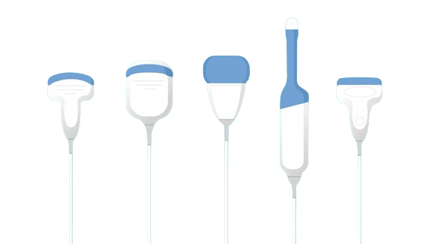

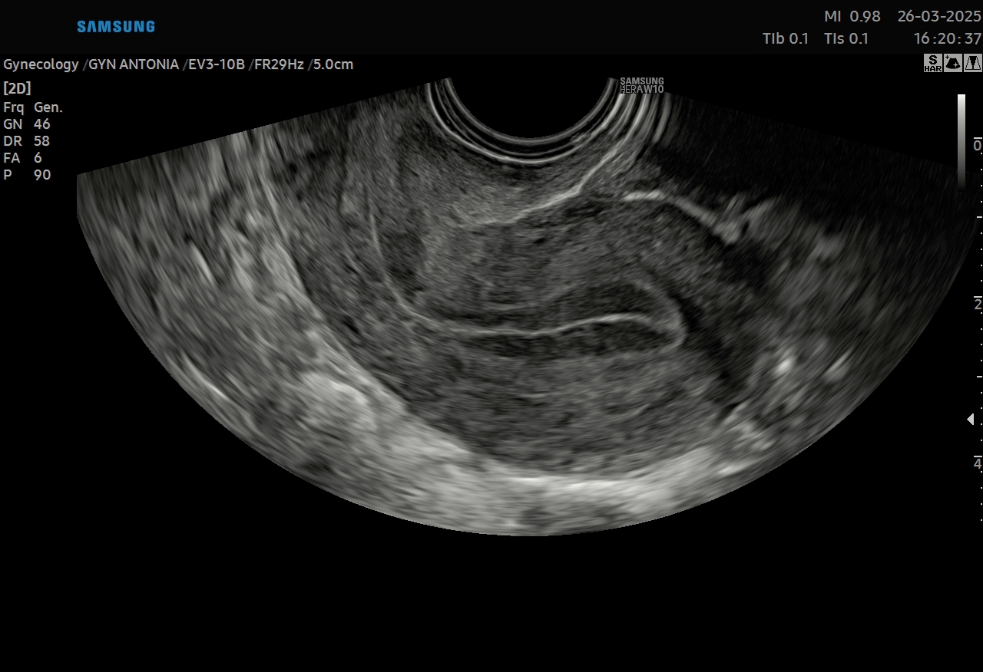
Machine Settings (check box or add a different setting)

Slide 7
Video Clip – 2D Scan Throughout the Lesion
Show an anonymized grayscale video demonstrating the uterus, endometrium, and relevenat lesion(s).
Please demonstrate mobility where relevant.

Slide 8
Video Clip 2 – Vascularization
Show an anonymized Color Doppler video of the lesion.(s)
Please include only videos with correctly set PRF.

Slide 9
Images – Additional Ultrasound Tools
Show 3D Imaging (Render, TUI, Multiplanar, 3D Doppler...)
if available
Otherwise remove this slide

Slide 10
STEP 1:
Routine evaluation of the adnexa
Comment on
Adenomyosis
Endometrioma
ADD VIDEO OR 2D GREYSCALE

Slide 11
STEP 2:
Comment on
Site specific tenderness
Ovarian mobility
ADD VIDEO OR 2D GREYSCALE

Slide 12
STEP 3:
Assessment of pouch of douglas
Please comment on mobility
ADD VIDEO OR 2D GREYSCALE

Slide 13
STEP 4:
Assessment of the anterior and posterior compartments
Please use the maps on the following slide to help guide your descriptions
ADD VIDEO OR 2D GREYSCALE

Slide 14
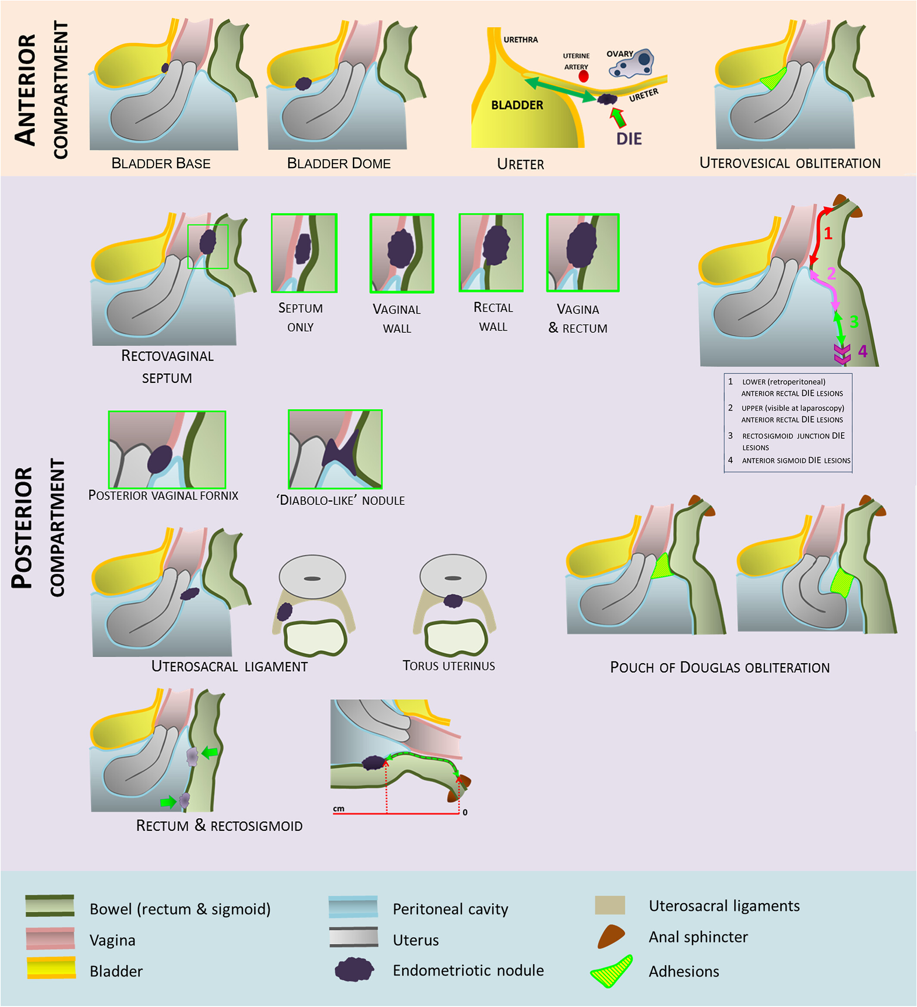
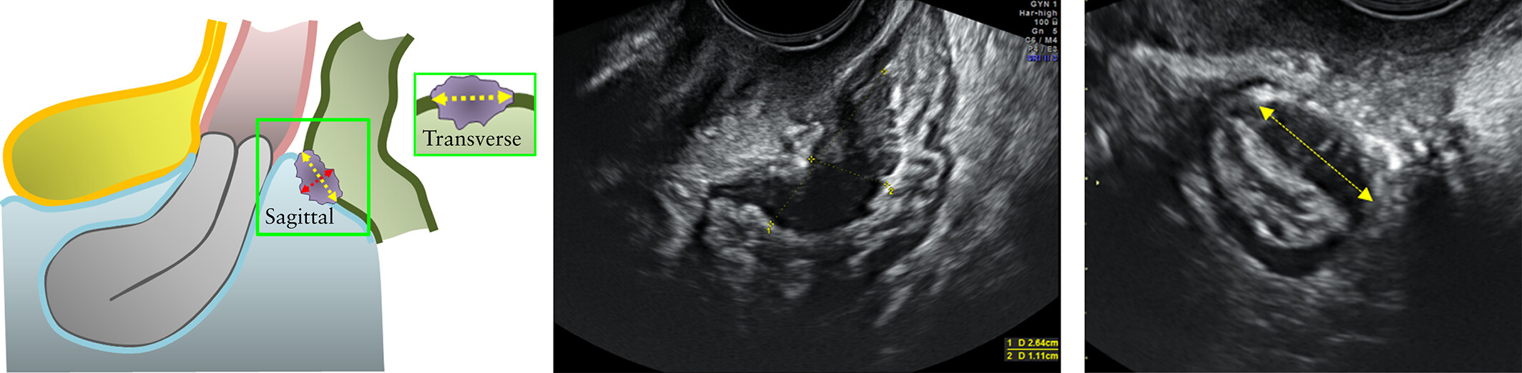
REMOVE THIS SLIDE

Slide 15

Management
Surgery/follow up…
…
Notes:
Surgery or follow up

Slide 16
Case Outcome
Macroscopic image

Slide 17



Case Outcome
Histology, slide (if available)
Final Histology
….

Slide 18
Case relevance
Why is this case relevant? (check one or more)
Very didactic (typical features)
Special outcome (atypical features)
Special ultrasound images
Other…

Slide 19
Literature

Slide 20
Literature

