Slide 1
EPC Case Competition
Add your name and department here

Slide 2

Case Example Contest
Share your interesting case with us
Use the template in the following slides
Remember to remove patient identifiable data
from the images/clips – do not just crop the image
Follow the instructions in the last slide
to upload the prepared case
3 cases will be featured on our stream
Winners will get a full year
EPC Programme membership
Please confirm the following statements by adding an ‘x’ in the box:
(*) I confirm that there is no patient-identifiable information in the slides submitted and that I have obtained appropriate consent to share this case. I understand that if my case is selected for presentation, the Case Stream session will be recorded and made available online to registered Gynaia members.
I would like my case to be included in the upcoming Gynaia Case Database,
    an educational and interactive online resource
    with real-world case examples supporting the EPC community.
I am willing to be contacted to provide additional details
    that could enhance the case and help develop it into a high-quality example
    for Case Stream and educational use
(*) Obligatory field

Slide 3
Essential Patient Information
On this slide you can include essential patient information to allow for interpretation of the case
Please keep this pseudonymised e.g. ‘a woman in her 30s’
Do not include any irrelevant past medical history
Essential information would usually include Gravidity, Parity and history of pain, bleeding or subfertility

Slide 4
Images
Please add your images to this black background
You may wish to present your case as a timeline
Ideally please include US images of the uterus and both ovaries
Video clips are preferable over still images
You can duplicate this slide as needed
Add descriptions of your images including the presence/absence and measurements of: gestational sac, amnion, yolk sac, CRL, heartbeat
If any adnexal mass is present, it should be describe using IOTA terms and definitions

Slide 5
Management
Describe the management plan that was chosen and the rationale

Slide 6
Outcome
On this slide you can include any relevant surgical findings and histological outcomes
You may wish to include any images taken intraoperatively or of specimens

Slide 7
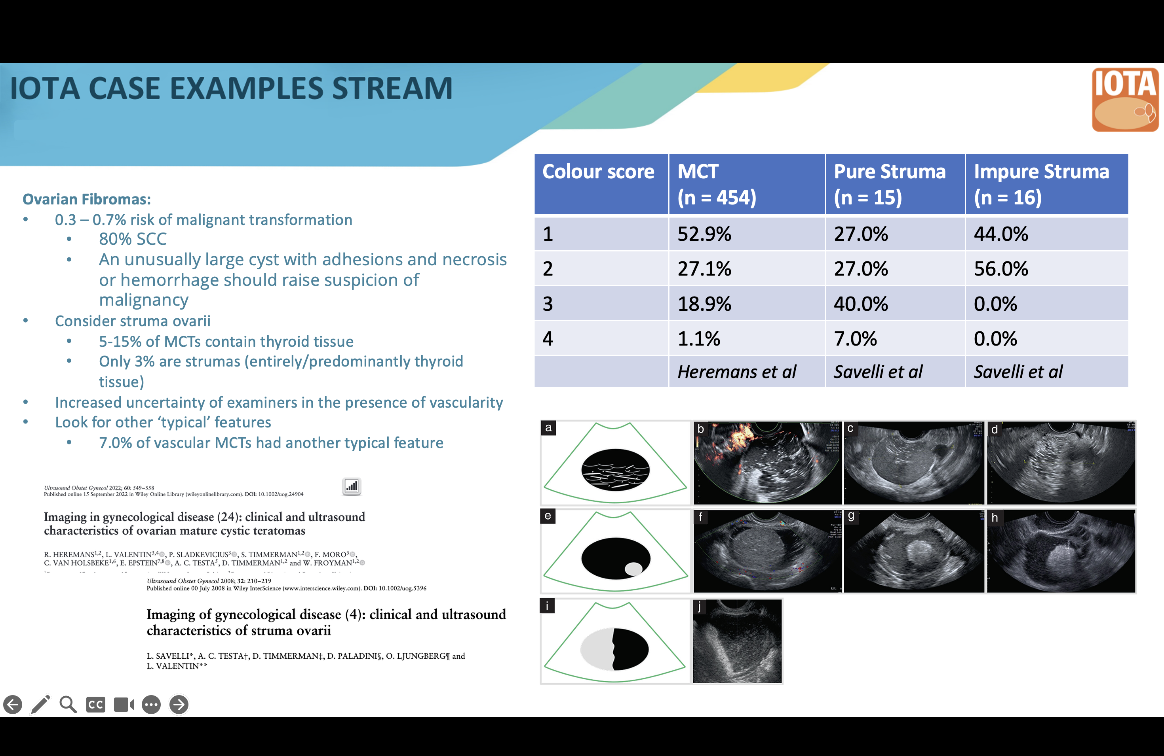
Literature
Add a slide here to briefly explain the diagnosis – please see the below example from a previous stream

Slide 8
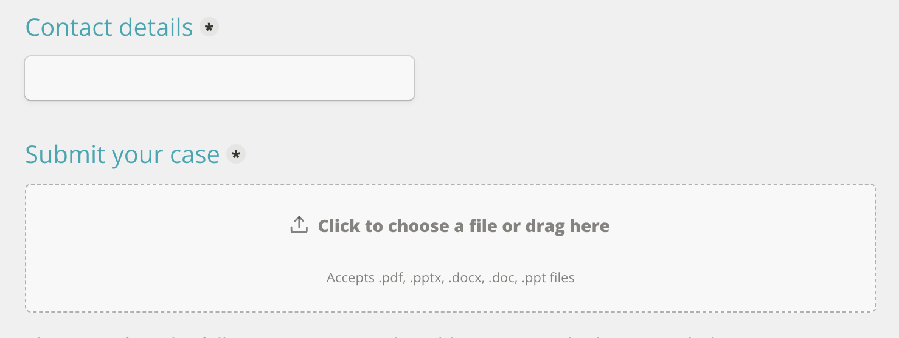
How to upload
Go to the submit form:
https://forms.gynaia.com/casescontest/epc/e1/submit
Provide your contact details & upload your case under the 'submit your case' section:
Submit the case

