Slide 1
CASE ADENOMYOSIS MUSA dd-mm-yy

Slide 2

Consent
Please confirm the following statements by adding an ‘x’ in the box:
(*) I confirm that there is no patient-identifiable information in the slides submitted and that I have obtained appropriate consent to share this case. I understand that if my case is selected for presentation, the Case Stream session will be recorded and made available online to registered Gynaia members.
(*) I would like my case to be included in the upcoming Gynaia Case Database, an educational and interactive online resource with real-world case examples
(*) I am willing to be contacted to provide additional details that could enhance the case and help develop it into a high-quality example for Case Stream and educational use.

Slide 3


Acknowledgments
Case provided by:
Name
Institution
City (Country)

Slide 4

Patient Information
AGE
MENOPAUSE
PARITY
SYMPTOMS
MEDICAL HISTORY
ONCOLOGICAL CENTER
…
…
…
…
…
…

Slide 5
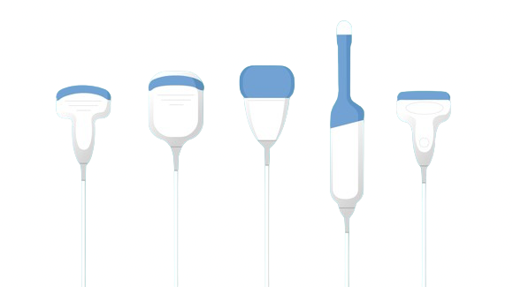

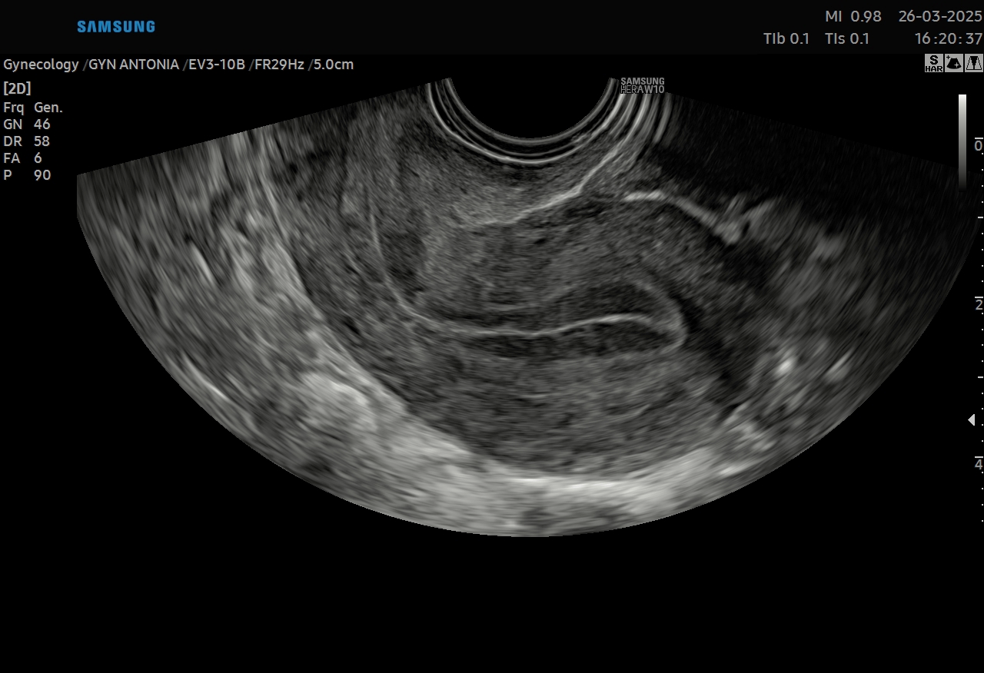
Machine Settings (check box or add a different setting)

Slide 6
Video Clip – 2D Scan Throughout the Lesion
Please include anonymized video

Slide 7
Video Clip 2 – Vascularization
Please include anonymized video
Please include only video(s) with correctly set PRF

Slide 8
Images – Ultrasound Features 2D
Show all three dimensions of the myometrial lesion or uterus with measurements on screen

Slide 9
Images – Ultrasound Features Doppler
Show Color Doppler of the uterus/myometrial lesion
Show Color Doppler image(s)
(if present)
Please only include images with correctly set PRF

Slide 10
Images – Additional Ultrasound Tools
3D Imaging (Render, TUI, Multiplanar, 3D Doppler...)
if available
Otherwise remove this slide

Slide 11
Images – Supplementary Images
if applicable or available
Otherwise remove this slide

Slide 12
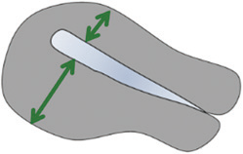
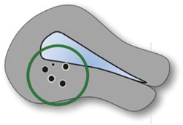
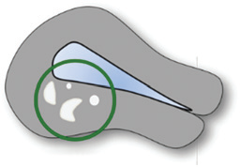
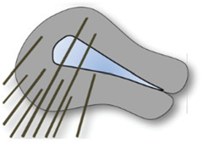
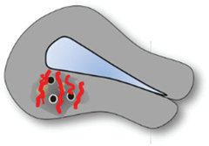
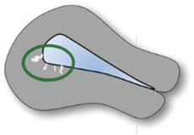
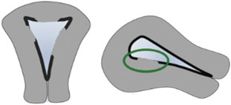
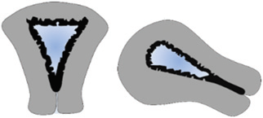
Ultrasound features of lesion
Are there any ultrasound features of adenomyosis?
Asymmetrical thickening
Myometrial cysts
Hyperechoic islands
Fan-shaped shadowing
Translesional vascularity
Echogenic subendometrial lines and buds
Irregular and interrupted junctional zone

Slide 13


Ultrasound features of lesion
DIRECT FEATURES
Myometrial cysts
Hyperechoic islands
Echogenic subendometrial lines and buds
Insert an ultrasound image or a videoclip of the uterus here
INDIRECT FEATURES
Fan-shaped shadowing
Irregular and interrupted junctional zone
Translesional vascularity
Asymmetrical thickening

Slide 14
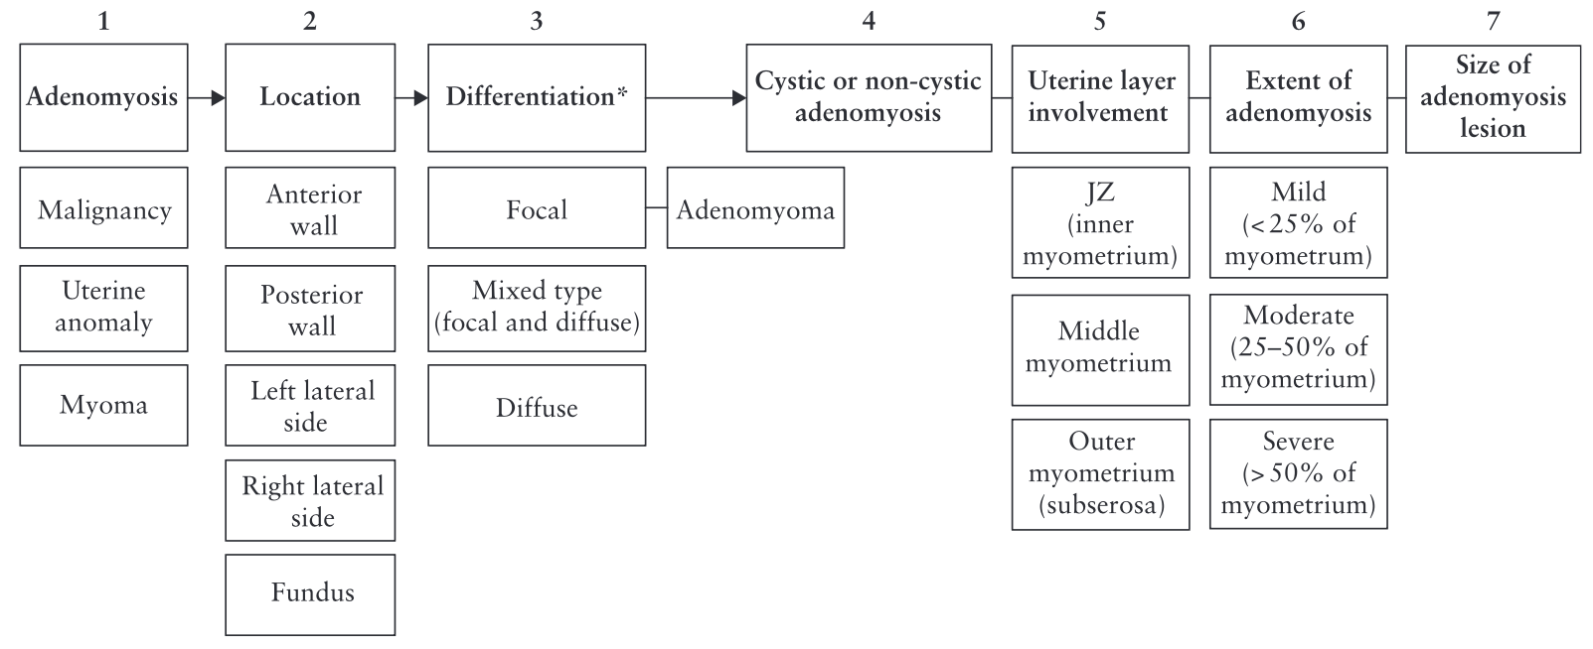
Ultrasound features of lesion
How can you the describe the LOCATION?
Van den Borsch, UOG 2019

Slide 15
Ultrasound features of lesion
LOCATION
e.g. Anterior wall
Insert an ultrasound image or a videoclip of the uterus here

Slide 16
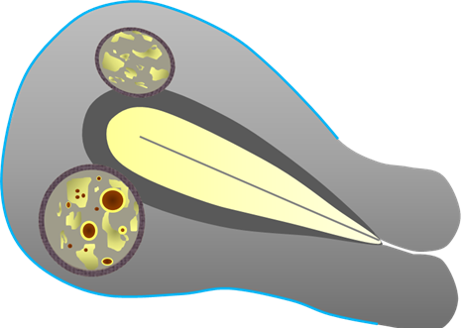
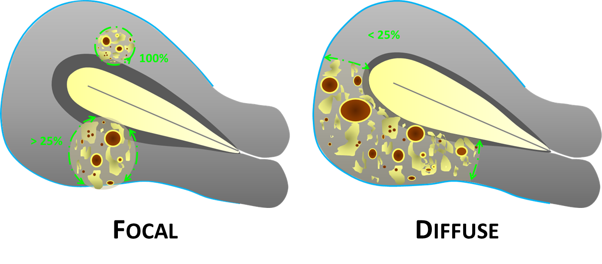
Ultrasound features of lesion
How can you the describe the DIFFERENTIATION?
Van den Borsch, UOG 2019

Slide 17
Ultrasound features of lesion
LOCATION
e.g. Anterior wall
DIFFERENTIATION
e.g. Focal Type
Insert an ultrasound image or a videoclip of the uterus here

Slide 18
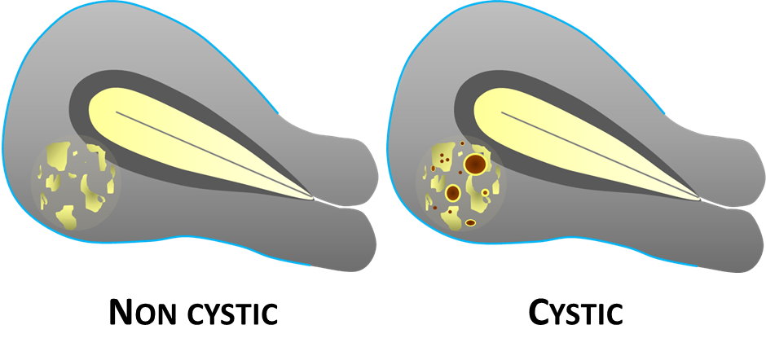
Ultrasound features of lesion
Are any CYSTIC area present?
Van den Borsch, UOG 2019

Slide 19
Ultrasound features of lesion
LOCATION
e.g. Anterior wall
DIFFERENTIATION
e. g. Focal Type
Insert an ultrasound image or a videoclip of the uterus here
CYSTIC OR NON-CYSTIC
e.g. Cystic

Slide 20
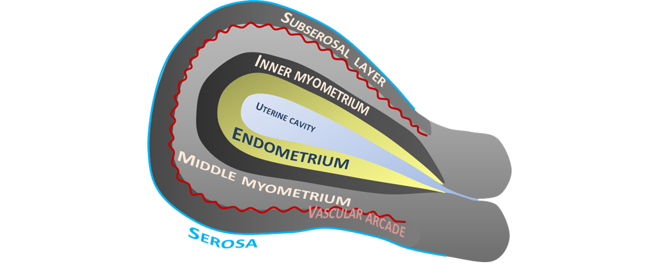
Ultrasound features of lesion
Which UTERINE LAYER is involved?
Van den Borsch, UOG 2019

Slide 21
Ultrasound features of lesion
LOCATION
e.g. Anterior wall
DIFFERENTIATION
e.g. Focal Type
Insert an ultrasound image or a videoclip of the uterus here
CYSTIC OR NON-CYSTIC
e.g. Cystic
LAYER INVOLVEMENT
e.g. Junctional zone

Slide 22
Ultrasound features of lesion
How can you describe the EXTENSION?
Van den Borsch, UOG 2019

Slide 23
Ultrasound features of lesion
LOCATION
e.g. Anterior wall
DIFFERENTIATION
e.g. Focal Type
Insert an ultrasound image or a videoclip of the uterus here
CYSTIC OR NON-CYSTIC
e.g. Cystic
LAYER INVOLVEMENT
e.g. Junctional zone
EXTENT
e.g. Mild

Slide 24

Management
Surgery/Therapy/Follow-up
Specify the managment

Slide 25
Case Outcome
Insert here macroscopy image (gross section)
We highly recommend to include macroscopy, if applicable

Slide 26

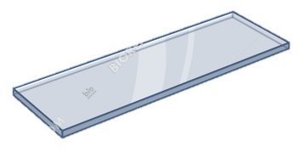

Case Outcome
Insert here macroscopy image (gross section)
We highly recommend to include macroscopy, if applicable
Final Histology
Specify the final histology

Slide 27
Case relevance
Why is this case relevant? (check one or more)
Very didactic (typical features)
Special outcome (atypical features)
Special ultrasound images
Other…

Slide 28
Literature
Drop here references of the main publications on the topic (URLs) - if available

